Slide 1

DATA ENGINEERING 1
TRADEOFFS OF DATA ARCHITECTURES
Laszlo Sallo
OCTOBER 2021

Slide 2
PRACTICE USERNAME / PASSWORD
aftab_alam
fatima_arshad
ghazal_ayobi
andras_bognar
balint_bojko
haaris_cheema
abigail_christine_chen
xibei_chen
oszkar_egervari
peter_endes_nagy
syed_shah_ali_gardezi
daniel_gyebnar
nawal_zehra_hasan
natalia_iriarte
ferenc_kaiser
gyongyver_kamenar
mahrukh_khan
maryam_khan
viktoria_konya
adam_kovacs
ersan_kucukoglu
nadine_levin
rauhan_nazir
nam_son_nguyen
benjamin_salga
ali_sial
sabina_umarova
sara_vargha
muhammad_zahid
http://de.ceudata.net/
http://aws.amazon.com/
Password: “slowmotion2”
User:
Password: “CEUba2222”
User: CEU email

Slide 3








DATA LANDSCAPE BEFORE 2010

Slide 4
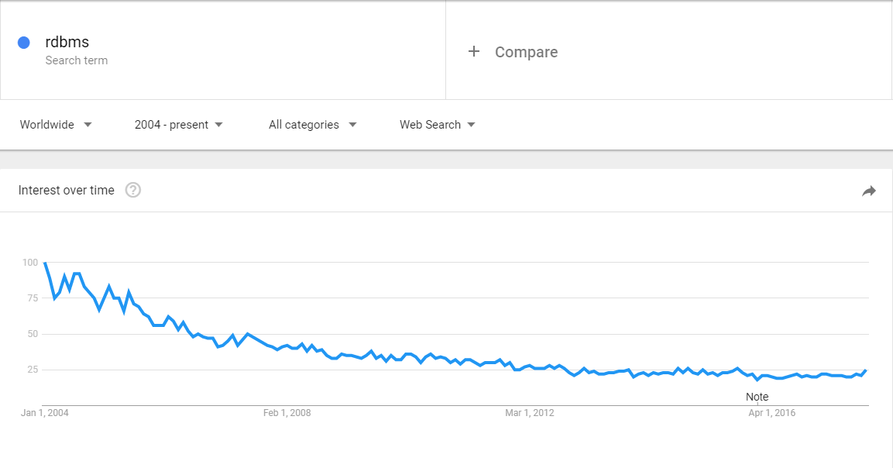
RDBMS

Slide 5
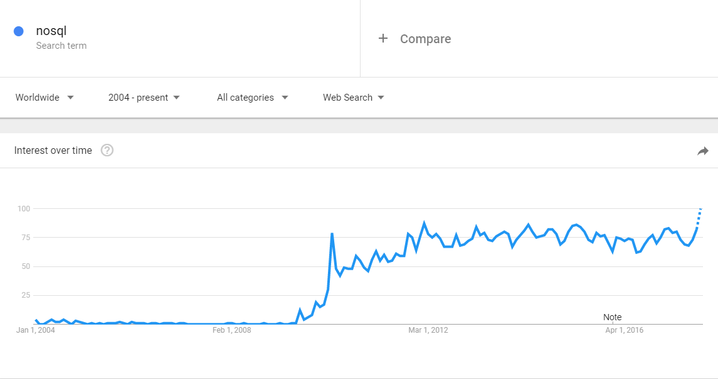
NOSQL

Slide 6
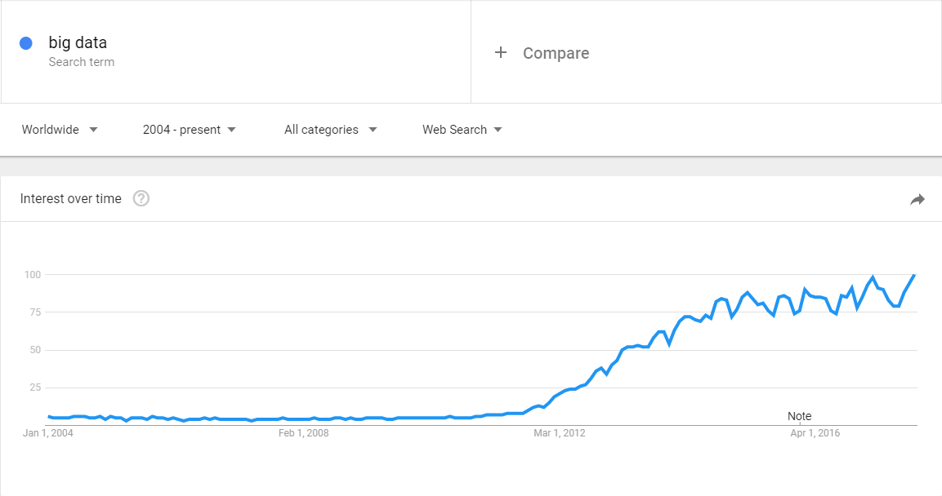
BIG DATA

Slide 7

DATA SYSTEM REVOLUTION IN LATE 2000’S

Slide 8
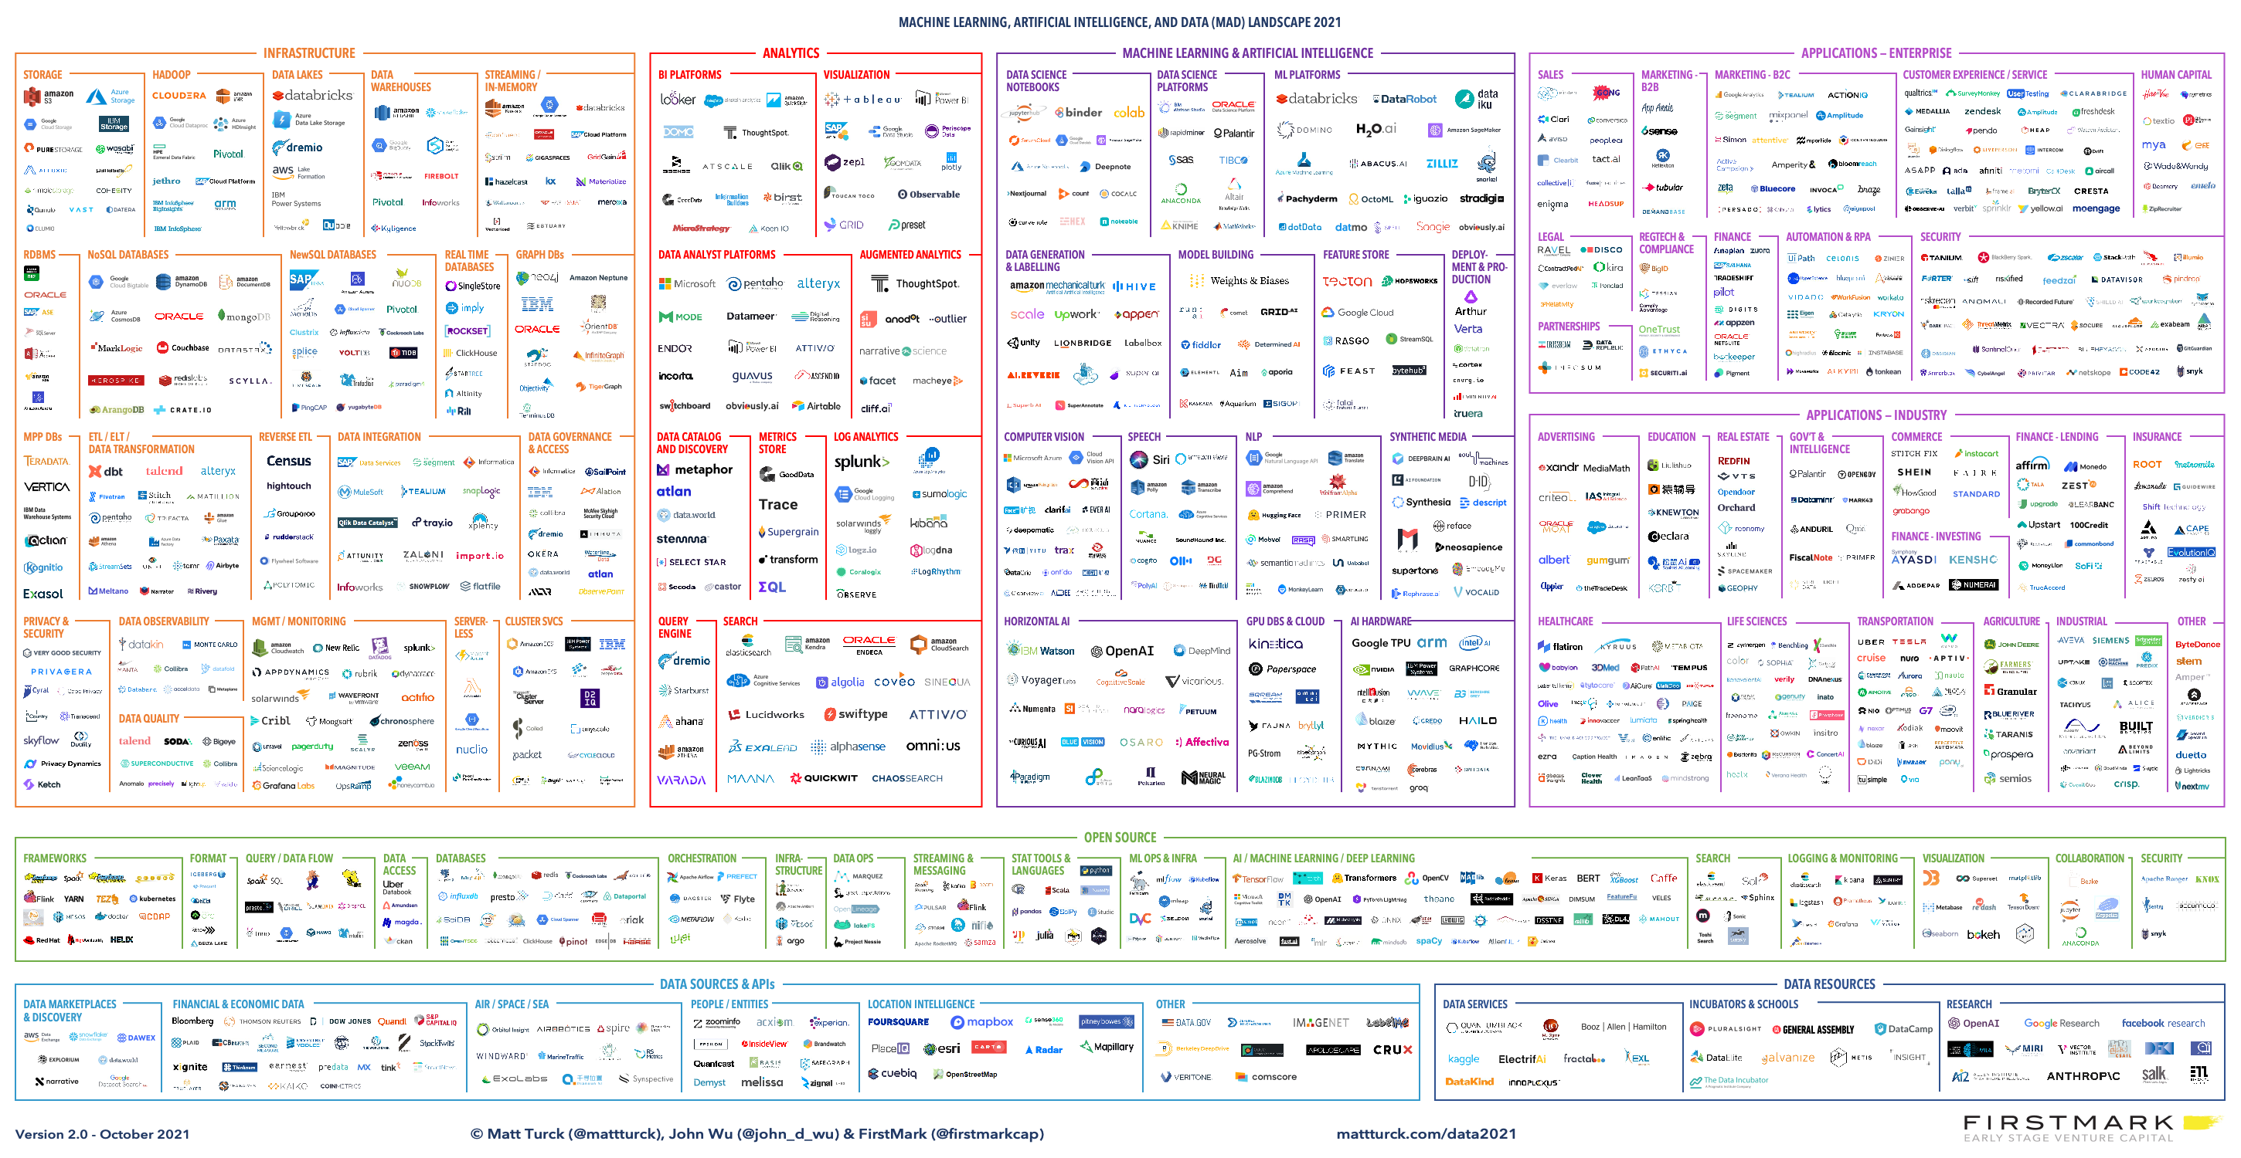

Slide 9



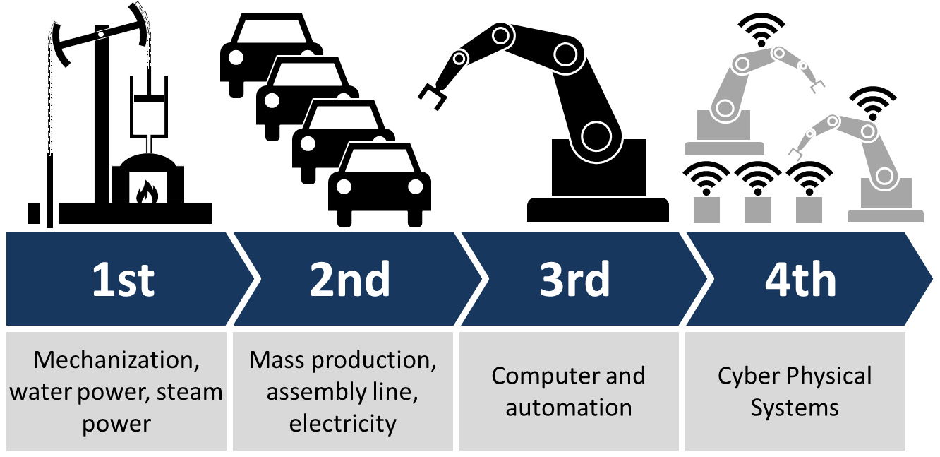
CATALYSTS OF CHANGE
SOCIAL MEDIA
MOBILITY
DIGITAL TRANSFORMATION
IoT / INDUSTRY 4.0

Slide 10

CHANGE AGENT
STARTUPS

Slide 11
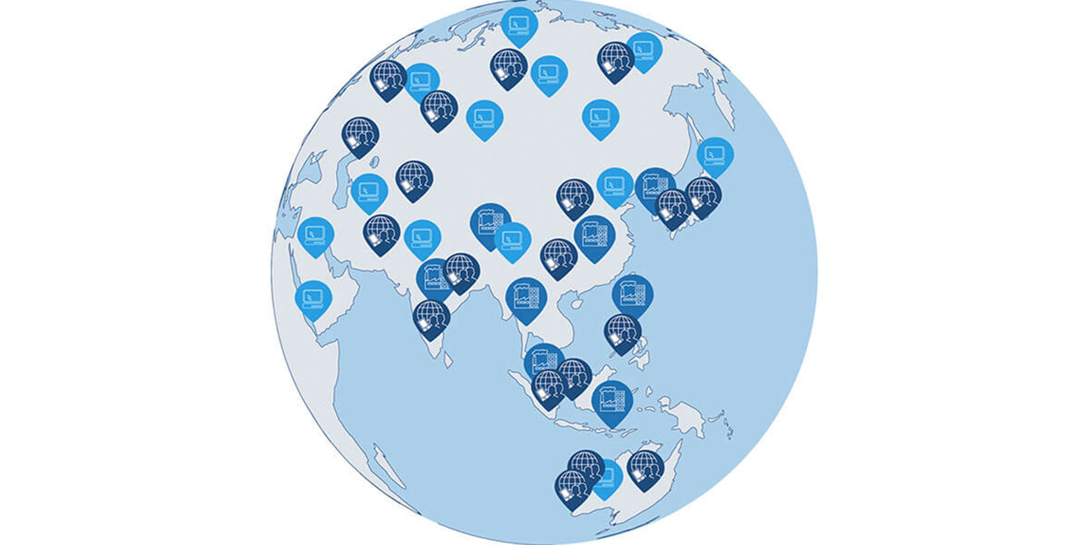
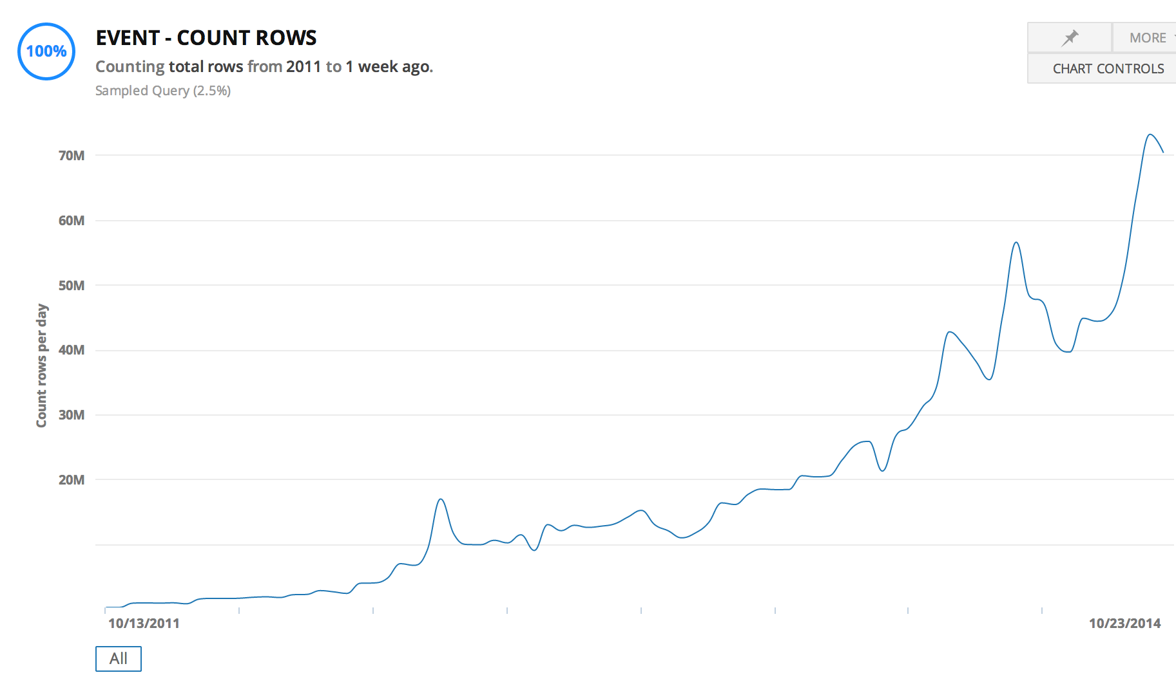

STARTUPS
GLOBAL ENTERPRISE
WITH HYPER SCALE CAPACITY

Slide 12



CHANGE AGENT
OPEN SOURCE SOFTWARE IS SOFTWARE WITH SOURCE CODE THAT ANYONE CAN
INSPECT,
MODIFY,
OR ENHANCE.

Slide 13
COST OF STORAGE / COST OF COMPUTATION
1 Gigabyte
$2.64 billion in 1965
$0.09 in 2020 (India)

Slide 14
THE CHANGE
SOLUTIONS for
real time + highly available + large DATA
in
economically feasible way
Notes:
Automated cars
Real-time bidding (RTB)
Stock exchange
Telemedicine
Blockchain

Slide 15
THE FIRST IDEA: DISTRIBUTED SYSTEMS

Slide 16


SERVER – CLIENT ARCHITECTURE
CLIENT
CLIENT
CLIENT
SERVER

Slide 17
SCALING
CLIENT
CLIENT
CLIENT
VERTICAL
SCALING
SERVER

Slide 18

DISTRIBUTED SYSTEMS
CLIENT
CLIENT
CLIENT
HORIZONTAL
SCALING
SERVER CLUSTER
NODE 1
NODE 2
NODE 3
NODE 4

Slide 19
HORIZONTAL SCALING - REPLICATION
CLIENT
CLIENT
CLIENT
REPLICATION
SCALE ONLY FOR PERFORMANCE
LOAD BALANCER
SERVER CLUSTER
COMPANY
DATA
COMPANY
DATA
COMPANY
DATA
COMPANY
DATA

Slide 20
HORIZONTAL SCALING - PARTITIONING
CLIENT
CLIENT
CLIENT
PARTITIONING
HAVE TO KNOW WHERE TO GO
UNBALANCED
PROXY
SERVER CLUSTER
COMPANY
EUROPE
DATA
COMPANY
AMERICA
DATA
COMPANY
ASIA
DATA
COMPANY
AFRICA
DATA

Slide 21
HORIZONTAL SCALING - SHARDING
CLIENT
CLIENT
CLIENT
SHARDING
CAN BE SLOW
AGGREGATOR
SERVER CLUSTER
COMPANY
DATA A
COMPANY
DATA B
COMPANY
DATA C
COMPANY
DATA D

Slide 22
BARE METAL SERVER
ISSUES
COSTLY
COMPLICATED
HARD TO SCALE

Slide 23
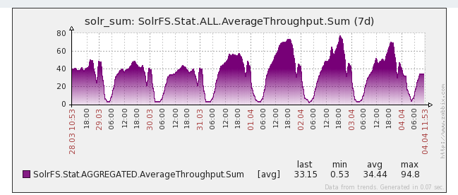
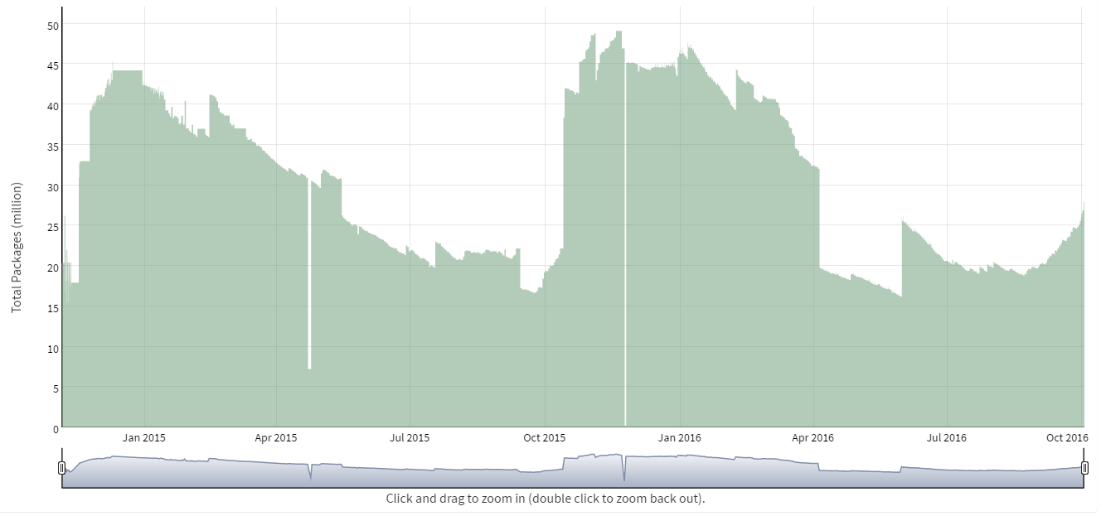
USE CASE
SEASONALITY OF REQUESTS (DAY)
SEASONALITY OF DATA SIZE (YEAR)

Slide 24

THE NEXT IDEA: TENANTS
RESOURCE RENTING (DATA CENTERS) DYNAMIC RESOURCE ALLOCATION (VIRTUALIZATION)

Slide 25
VIRTUALIZATION
ISSUES
COSTLY
COMPLICATED
HARD TO SCALE
SECURITY: PRIVATE VS PUBLIC

Slide 26

THE NEXT IDEA: CLOUD

Slide 27
USE CASE - AMAZON
…
5% utilized
NODE 1
NODE 2
NODE 3
NODE 4

Slide 28

CLOUD
2006

Slide 29
WHAT IS CLOUD?
A PIECE OF SOFTWARE WHICH OFFERS:
TOOLS TO REMOTELY AND SIMPLY HANDLE
VIRTUAL HARDWARE AND/OR SOFTWARE.

Slide 30
FURTHER BENEFITS
XAAS
IAAS – Infrastructure as a service
PAAS – Platform as a service
STAAS – Storage as a service
SAAS – Software as a service
DAAS – Database as a services
Serverless

Slide 31

AWS PRACTICE WITH MANAGED REDIS

Slide 32
CLOUD
ISSUES
COSTLY
COMPLICATED
HARD TO SCALE
SECURITY
BENEFITS
GEO SAFE
AUTOMATION
IAC (Infrastructure as code)

Slide 33
FINANCIAL CONDUCT AUTHORITY (UK)
We see no fundamental reason why cloud services (including public cloud services) cannot be implemented, with appropriate consideration, in a manner that complies with our rules.
(2016.07.07)
https://www.fca.org.uk/publications/finalised-guidance/fg16-5-guidance-firms-outsourcing-%E2%80%98cloud%E2%80%99-and-other-third-party-it

Slide 34



CLOUD PROVIDERS

Slide 35

THE NEXT IDEA: BUILD NEW TOOLS

Slide 36
RDBMS IN A NEW PERSPECTIVE
RDBMS
= DESIGNED FOR OPERATIONS
= DESIGNED TO BE PERFECT IN EVERY SITUATION

Slide 37
CHARACTERISTICS OF RDBMS
Consistency is always guaranteed
Consistency over availability
Fully available or not available at all
…
FOR MORE READ ABOUT: ACID & CAP
Notes:
Consistency: Availability correlates with revenue and consistency generally does not.
Availability: partial availably ?
100% PERFECT
= $$$$$

Slide 38

DO WE REALLY NEED RDBMS PERFECTION?

Slide 39
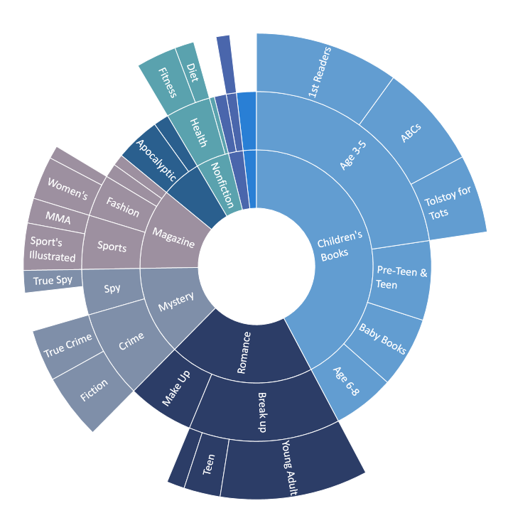
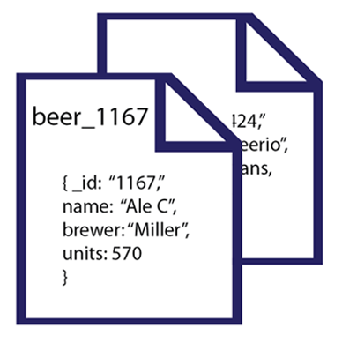
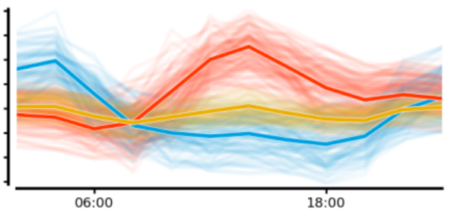
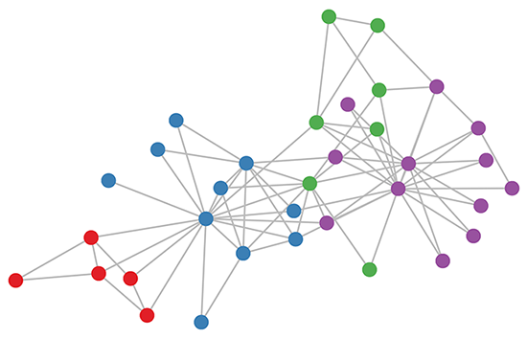
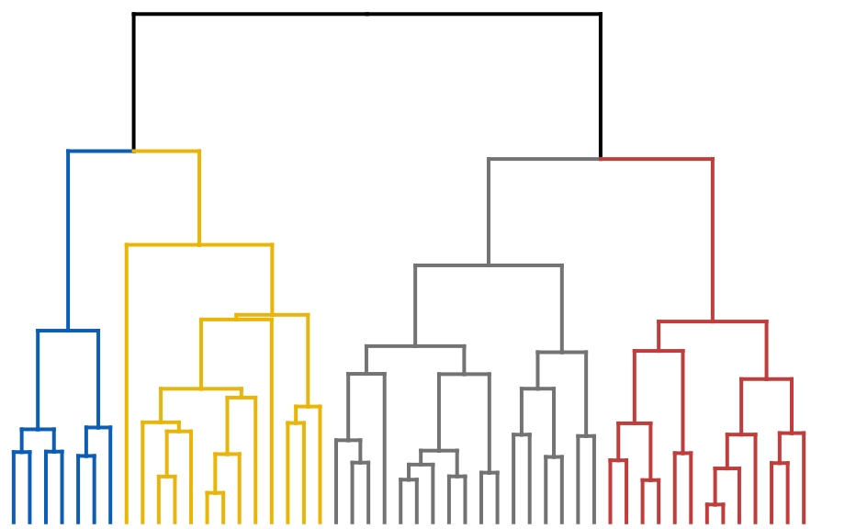
CAN WE GO BEYOND TABULAR DATA?

Slide 40
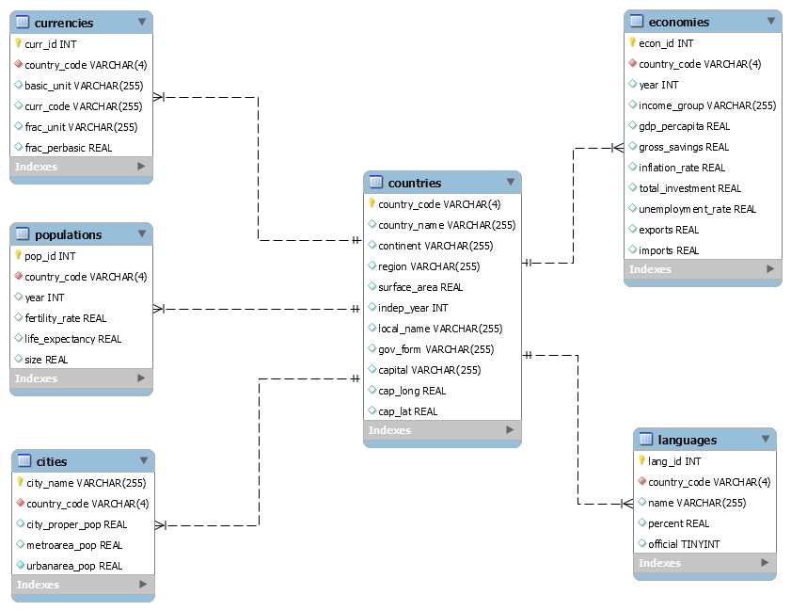
DO WE NEED THOSE RIGID SCHEMAS?

Slide 41


SPECIALIZED
NEW TOOLS
RDBMS

Slide 42
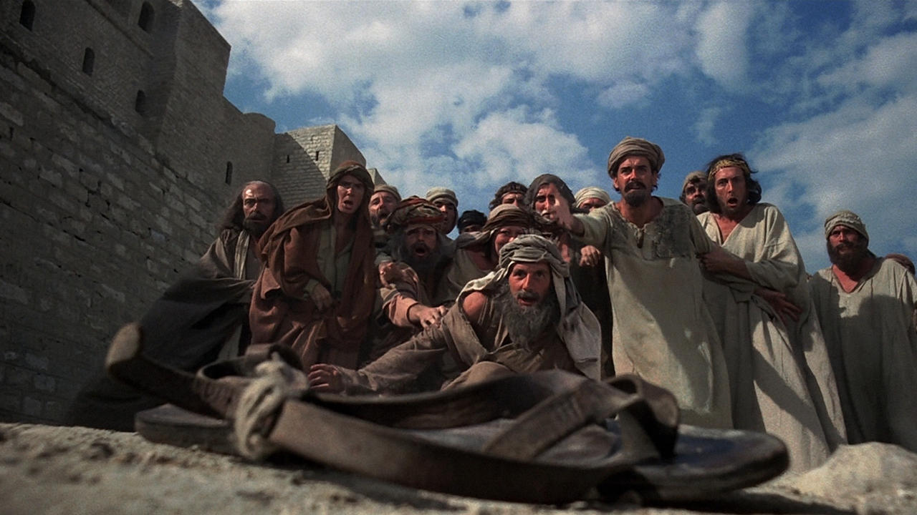
BIG DATA, NOSQL, …

Slide 43

NOSQL

Slide 44
INTEGRITY AND CONSISTENCY
BASICALLY AVAILABLE
SOFT STATE
EVENTUAL CONSISTENCY
BASE

Slide 45
INTERFACE
SQL
ActionScript Bash C C# C++ Clojure Common Lisp Crystal D Dart Delphi Elixir emacs lisp Erlang Fancy gawk GNU Prolog Go Haskell Haxe Io Java Julia Lasso Lua Matlab mruby Nim Node.js Objective-C OCaml Pascal Perl PHP PL/SQL Pure Data Python R Racket Rebol Ruby Rust Scala Scheme Smalltalk Swift Tcl VB VCL Xojo …

Slide 46

SCHEMALESS OR SCHEMA FREE
A SMART DATABASE CAN FIGURE OUT
THE DATATYPE
THE STRUCTURE

Slide 47
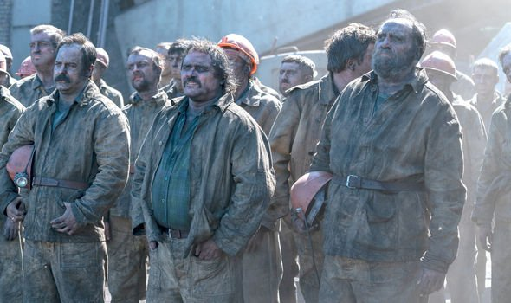
ALGORITHMS DEEP IN THE DATABASE
NO NEED TO MINE

Slide 48

MADE FOR CLOUD

Slide 49
NOSQL CLASSIFICATION
KEY-VALUE STORES
TIME SERIES DBMS
DOCUMENT STORES
COLUMN STORES
SEARCH ENGINES
GRAPH DBMS
100s
OF NOSQL
SOLUTIONS

Slide 50
DB-ENGINES.COM
YOUR ULTIMATE SOURCE TO
EXPLORE
http://db-engines.com/en/system/MySQL
http://db-engines.com/en/system/Elasticsearch
CATEGORIZE / KNOW THE TRENDS
http://db-engines.com/en/ranking_categories
http://db-engines.com/en/ranking_osvsc
http://db-engines.com/en/ranking_trend
COMPARE
http://db-engines.com/en/system/Elasticsearch%3BMongoDB

Slide 51
THE NEW TOOLS
NOSQL
SET OF SOLUTIONS
PERFORMANCE ORIENTED
DATABASE
OPERATIONAL AND ANALYTICAL
STRUCTURED/ SEMI-STRUCTURED
BIG DATA
SET OF SOLUTIONS
DATA VOLUME ORIENTED
DATA FRAMEWORK
ANALYTICAL
MAINLY UNSTRUCTURED

Slide 52
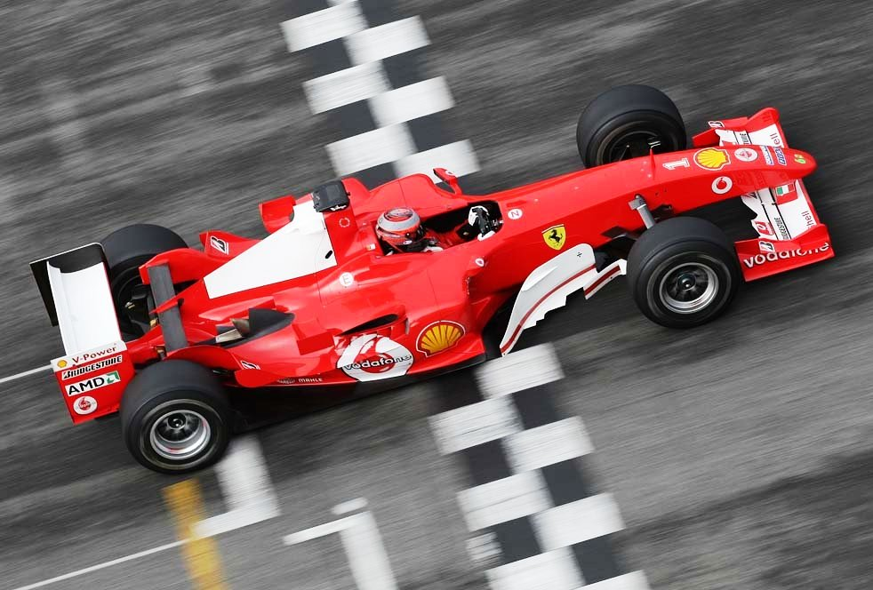
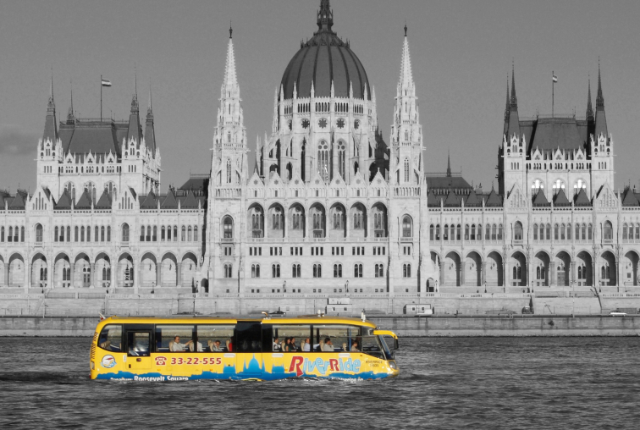
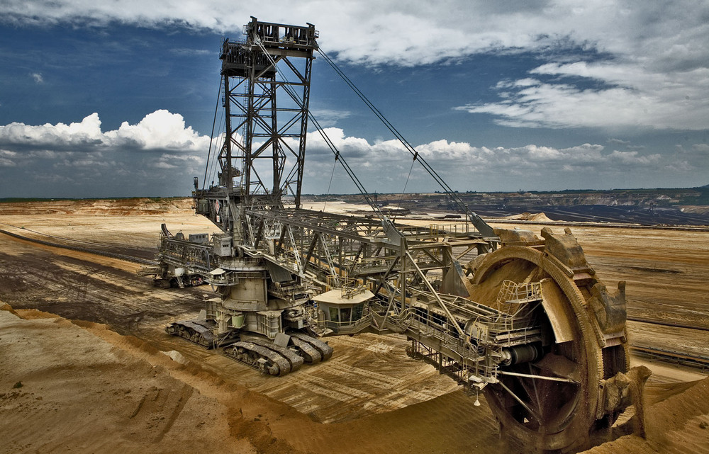
GAME
WHICH ONE YOU
WOULD ASSOCIATE
WITH
RDBMS,
NOSQL,
BIGDATA ?
1
2
3

Slide 53
NOSQL CLASSIFICATION
KEY-VALUE STORES
TIME SERIES DBMS
DOCUMENT STORES
COLUMN STORES
SEARCH ENGINES
GRAPH DBMS

Slide 54
KEY-VALUE DATA FORM - EXAMPLES
key | value
1 | John
2 | Mary
3 | Peter
key | value
War and Peace | ‘Well, Prince, so Genoa and Lucca are now just family …”
The Master and Margarita | “At the sunset hour of one warm spring day two men were to be seen …”
The Winter of Our Discontent | “I wonder how many people I've looked at all my life and never seen.”

Slide 55
KEY-VALUE STORE FEATURES
SIMPLEST DBMS VARIANT
EASY TO SCALE
HIGH PERFORMANCE (MANY TIMES IN MEMORY)

Slide 56
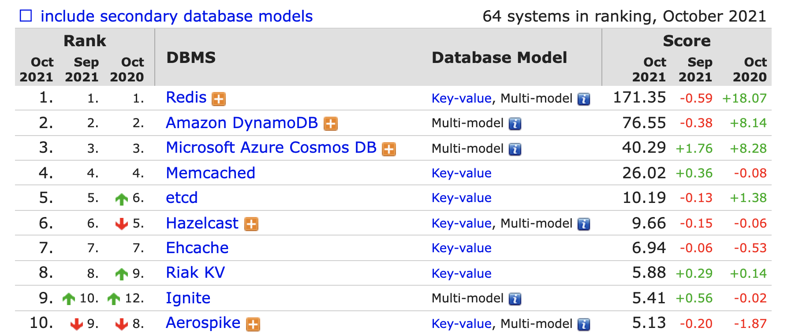
KEY-VALUE STORE RANK

Slide 57






REDIS IN CLOUD

Slide 58
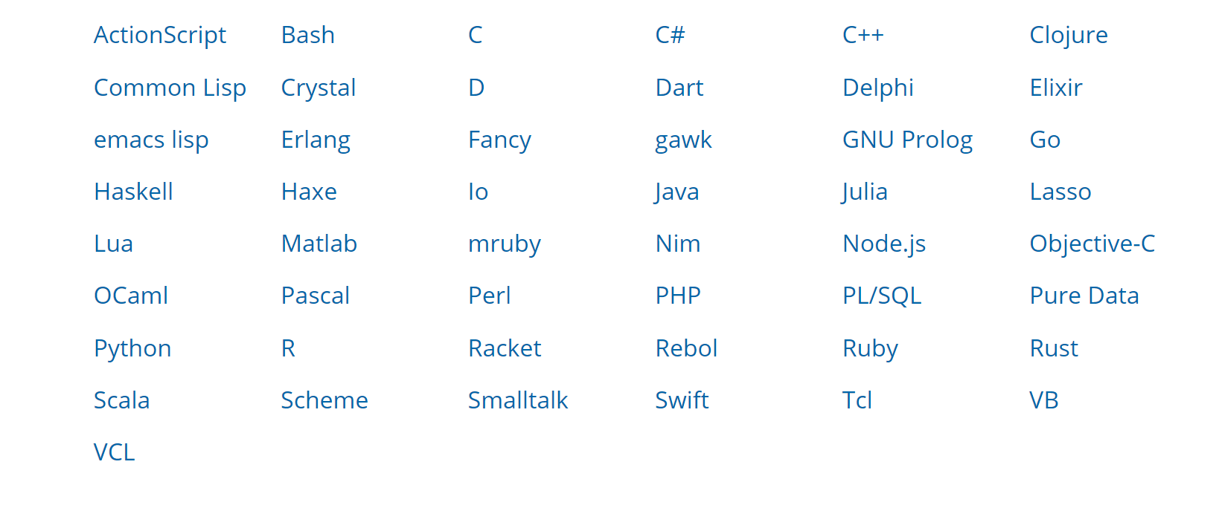
ACCESS REDIS

Slide 59
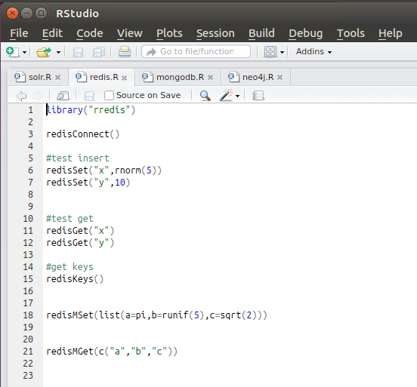
R STUDIO

Slide 60
REDIS PRACTICE WITH ZEPPELIN NOTEBOOK

Slide 61
NOSQL CLASSIFICATION
KEY-VALUE STORES
TIME SERIES DBMS
DOCUMENT STORES
COLUMN STORES
SEARCH ENGINES
GRAPH DBMS

Slide 62
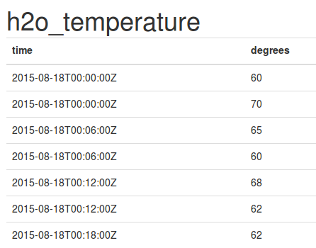
TIME SERIES DBMS
KEY: TIME
VALUE: TIME SERIES DATA (e.g. MEASUREMENT)

Slide 63
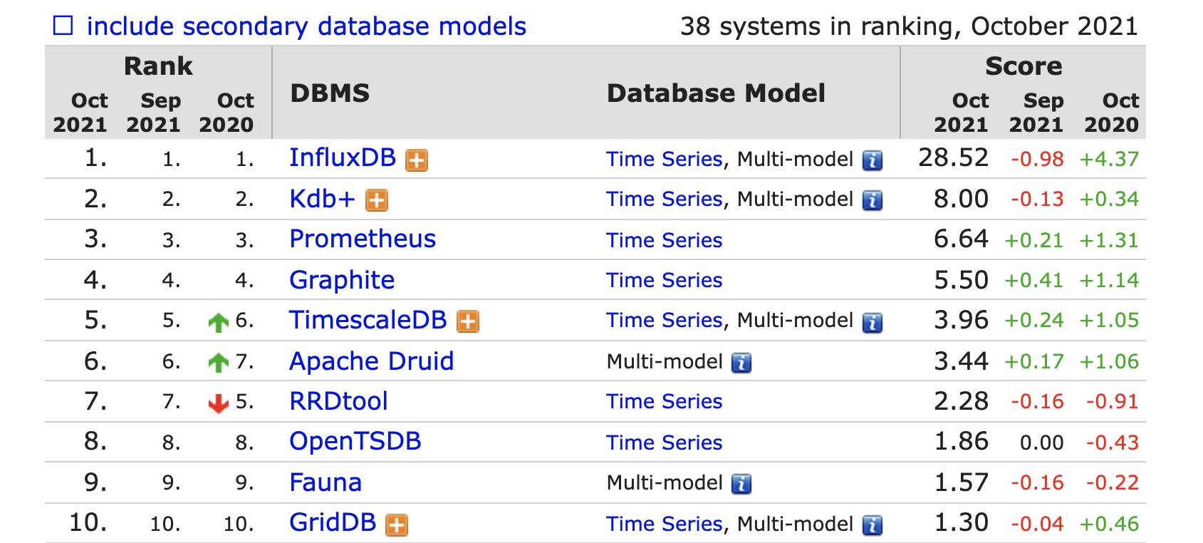
TIME SERIES DBMS

Slide 64
INFLUX DB FUNCTIONS
Aggregations | Selectors | Transformations | Predictors | Technical Analysis
COUNT() | BOTTOM() | ABS() | HOLT_WINTERS() | CHANDE_MOMENTUM_OSCILLATOR()
DISTINCT() | FIRST() | ACOS() |  | EXPONENTIAL_MOVING_AVERAGE()
INTEGRAL() | LAST() | ASIN() |  | DOUBLE_EXPONENTIAL_MOVING_AVERAGE()
MEAN() | MAX() | ATAN() |  | KAUFMANS_EFFICIENCY_RATIO()
MEDIAN() | MIN() | ATAN2() |  | KAUFMANS_ADAPTIVE_MOVING_AVERAGE()
MODE() | PERCENTILE() | CEIL() |  | TRIPLE_EXPONENTIAL_MOVING_AVERAGE()
SPREAD() | SAMPLE() | COS() |  | TRIPLE_EXPONENTIAL_DERIVATIVE()
STDDEV() | TOP() | CUMULATIVE_SUM() |  | RELATIVE_STRENGTH_INDEX()
SUM() |  | DERIVATIVE()
 |  | DIFFERENCE()
 |  | ELAPSED()
 |  | EXP()
 |  | FLOOR()
 |  | HISTOGRAM()
 |  | LN()
 |  | LOG()
 |  | LOG2()
 |  | LOG10()
 |  | MOVING_AVERAGE()
 |  | NON_NEGATIVE_DERIVATIVE()
 |  | NON_NEGATIVE_DIFFERENCE()
 |  | POW()
 |  | ROUND()
 |  | SIN()
 |  | SQRT()
 |  | TAN()

Slide 65
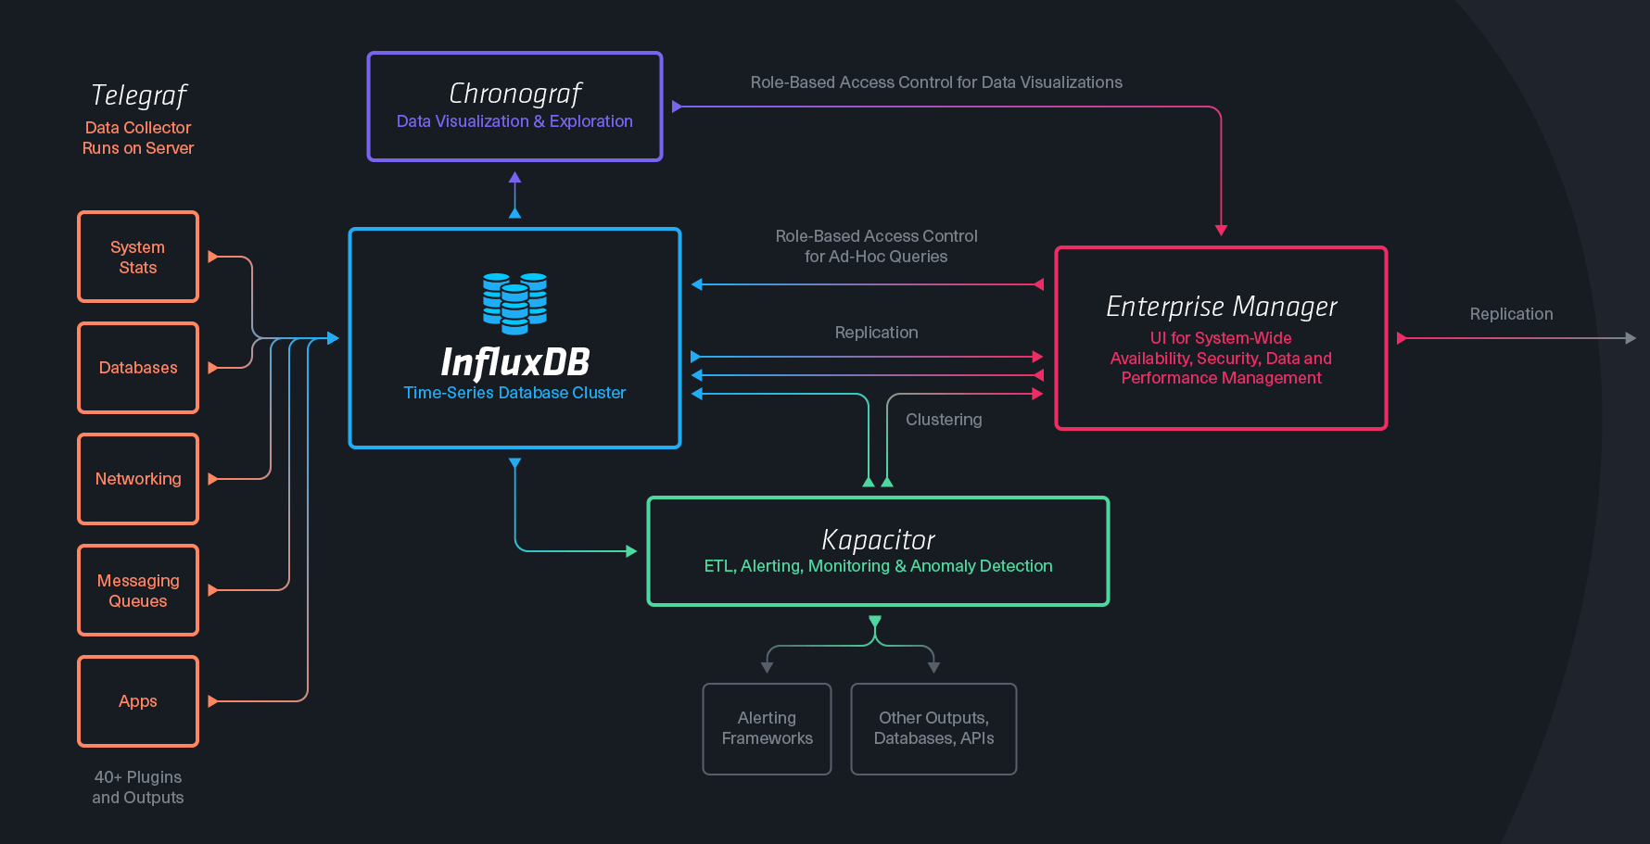

INFLUX TICK STACK

Slide 66

USE CASE EXAMPLE
VISUALIZE
IoT
Metrics Influx
(Aggregate)
PROCESSOR
SENSORS
Event Influx
(Interpret)
QUEUE
PROCESSOR
KEY VALUE
MONITOR

Slide 67
USE CASES
IOT
SYSTEM / INFRASTRUCTURE MONITORING
SMART CITY
INDUSTRY 4.0
ANOMALY DETECTION
TRADING DATA

Slide 68
NOSQL CLASSIFICATION
KEY-VALUE STORES
TIME SERIES DBMS
DOCUMENT STORES
COLUMN STORES
SEARCH ENGINES
GRAPH DBMS

Slide 69
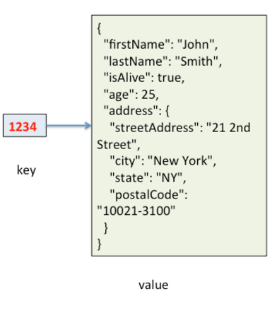
DOCUMENT STORES
KEY: ID
VALUE: QUERYABLE STRUCTURED DOCUMENT

Slide 70
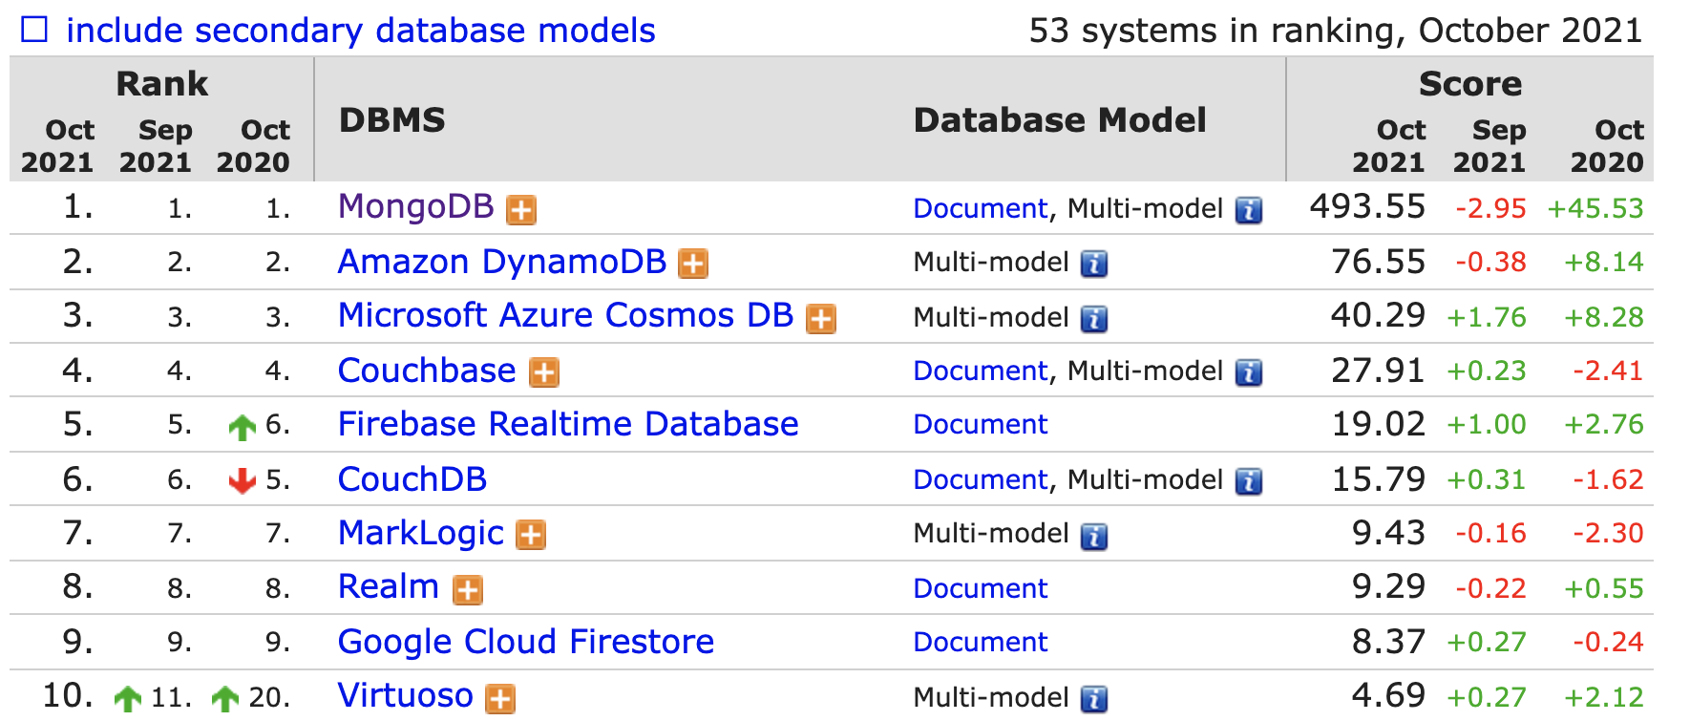
DOCUMENT STORES

Slide 71
MONGODB
THE MOST USED NOSQL
CLOSER TO GENERAL PURPOSE / SLOWER
HIGH AVAILABILITY / AUTOMATIC FAILOVER
HIGHLY SCALABLE / REBALANCING
DYNAMIC SCHEMA

Slide 72
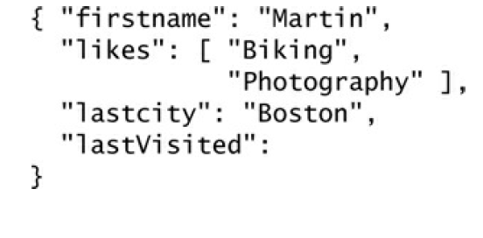
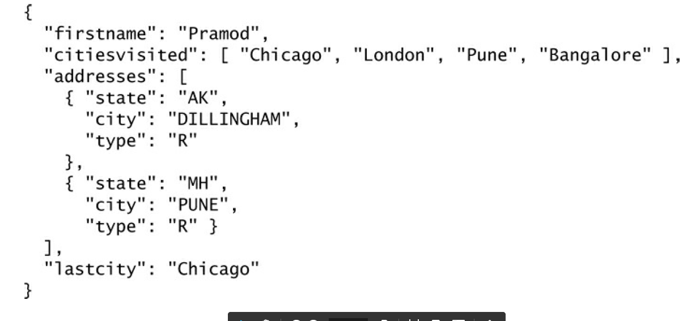
DYNAMIC SCHEMA

Slide 73




MONGO ACCESS
BI TOOLS
PROGRAMING LANGUAGES

Slide 74
USAGE
USE WHEN YOU CAN MAP YOUR DATA IN JSON
DO NOT USE WHEN
MONGO CAN’T HANDLE YOUR DATA SIZE
YOU NEED COMPLEX AGGREGATIONS
YOU HAVE COMPLEX RELATIONS
https://www.mongodb.com/industries/

Slide 75

MONGO PRACTICE WITH ZEPPELIN NOTEBOOK

Slide 76
NOSQL CLASSIFICATION
KEY-VALUE STORES
TIME SERIES DBMS
DOCUMENT STORES
COLUMN STORES
SEARCH ENGINES
GRAPH DBMS

Slide 77
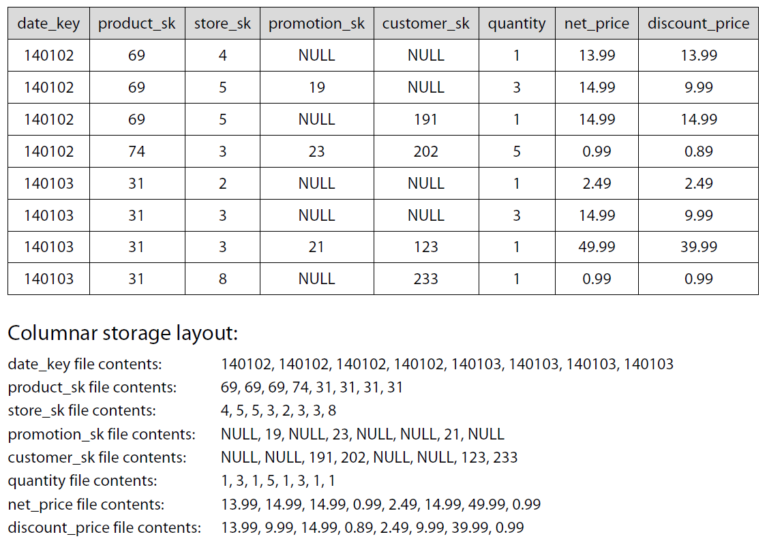
CLASSICAL DATA TABLE
140102 69 4 NULL NULL 1 13.99 13.99 140102 69 5 19 NULL 3 14.99 9.99 140102 69 5 NULL 191 1 14.99 14.99 140102 74 3 23 202 5 0.99 0.89 140103 31 2 NULL NULL 1 2.49 2.49 140103 31 3 NULL NULL 3 14.99 9.99 140103 31 3 21 123 1 49.99 39.99 140103 31 8 NULL 233 1 0.99 0.99
DISCOUNT PRICES FOR PRODUCT 31 ?

Slide 78
WIDE COLUMN STORES

Slide 79
COMPARE DISK ACCESS
CLASSICAL TABULAR DATA
140102 69 4 NULL NULL 1 13.99 13.99 140102 69 5 19 NULL 3 14.99 9.99 140102 69 5 NULL 191 1 14.99 14.99 140102 74 3 23 202 5 0.99 0.89 140103 31 2 NULL NULL 1 2.49 2.49 140103 31 3 NULL NULL 3 14.99 9.99 140103 31 3 21 123 1 49.99 39.99 140103 31 8 NULL 233 1 0.99 0.99
WIDE COLUMN STORES
140102 140102 140102 140102 140103 140103 140103 140103 69 69 69 74 31 31 31 31 4 5 5 3 2 3 3 8 NULL 19 NULL 23 NULL NULL 21 NULL NULL NULL 191 202 NULL NULL 123 233 1 3 1 5 1 3 1 1 13.99 14.99 14.99 0.99 2.49 14.99 49.99 0.99 13.99 9.99 14.99 0.89 2.49 9.99 39.99 0.99

Slide 80
COMPRESSION
CLASSICAL TABULAR DATA
140102 69 4 NULL NULL 1 13.99 13.99 140102 69 5 19 NULL 3 14.99 9.99 140102 69 5 NULL 191 1 14.99 14.99 140102 74 3 23 202 5 0.99 0.89 140103 31 2 NULL NULL 1 2.49 2.49 140103 31 3 NULL NULL 1 14.99 9.99 140103 31 3 21 123 1 49.99 39.99 140103 31 8 NULL 233 1 0.99 0.99
WIDE COLUMN STORES
140102 140102 140102 140102 140103 140103 140103 140103 69 69 69 74 31 31 31 31 4 5 5 3 2 3 3 8 NULL 19 NULL 23 NULL NULL 21 NULL NULL NULL 191 202 NULL NULL 123 233 1 3 1 5 1 1 1 1 13.99 14.99 14.99 0.99 2.49 14.99 49.99 0.99 13.99 9.99 14.99 0.89 2.49 9.99 39.99 0.99

Slide 81
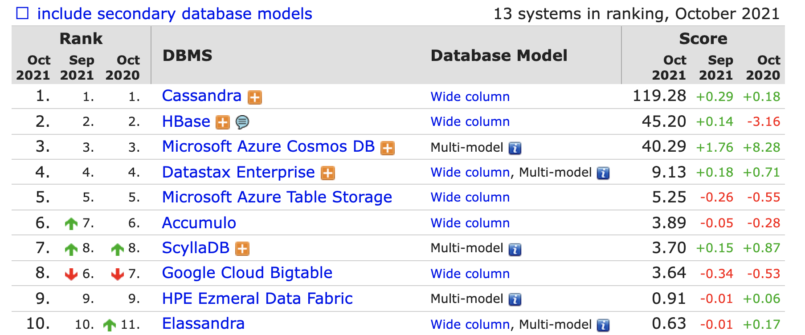
WIDE COLUMN STORE RANK

Slide 82
KEY FEAUTRES
FASTER ACCESS TIME WHEN YOU QUERY A FEW NEED DIMENSIONS
READ OPTIMIZED
HIGHLY SCALABLE BY DIMENSION
COMPRESSION
NEW GENERATION OF DW

Slide 83
NOSQL CLASSIFICATION
KEY-VALUE STORES
TIME SERIES DBMS
DOCUMENT STORES
COLUMN STORES
SEARCH ENGINES
GRAPH DBMS

Slide 84



MANY BUILT-IN FUNCTIONS
Facet search
Text Analysis
Geospatial Search
+ Build your own

Slide 85
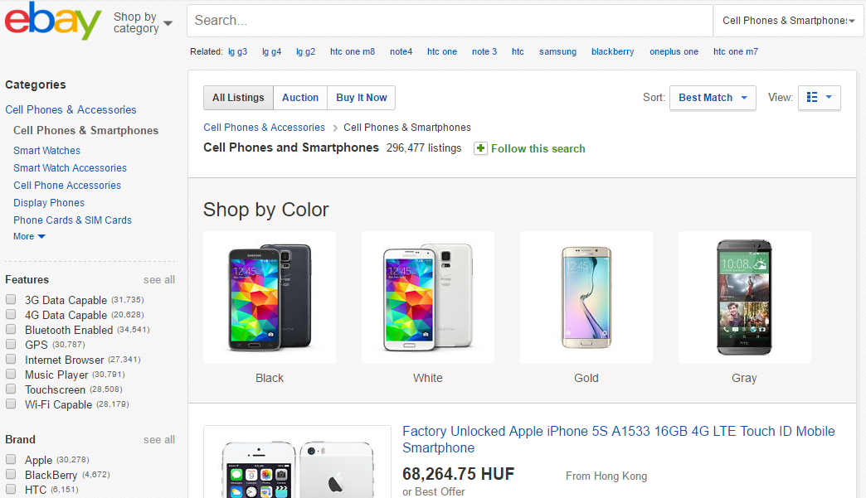
FACETED SEARCH

Slide 86
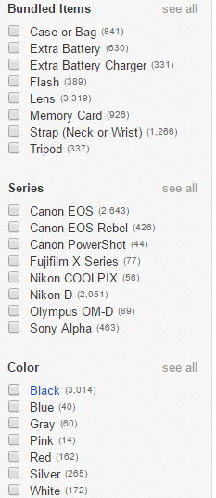
FACETED SEARCH
GUIDED QUERIES
E-COMMERCE: GUIDE YOUR CUSTOMERS
ANALYTICS: SLICING AND DICING, SELF SERVICE BI

Slide 87
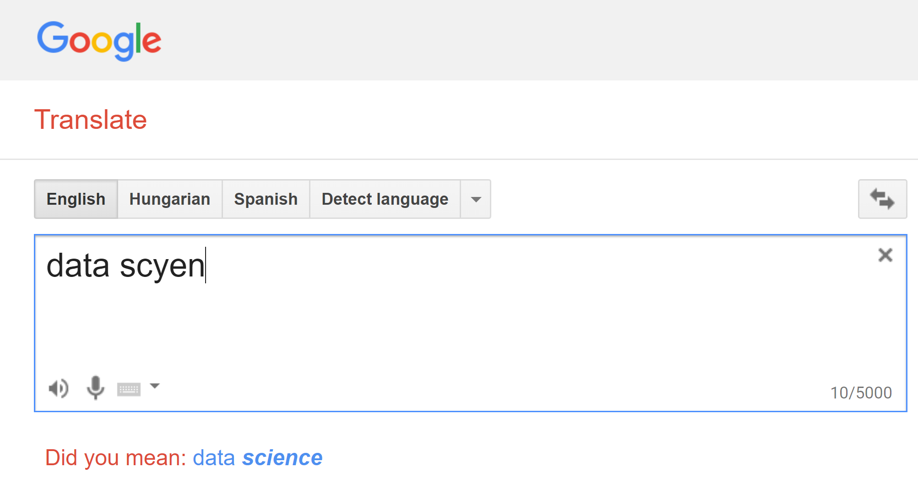
TEXT FUNCTIONS

Slide 88
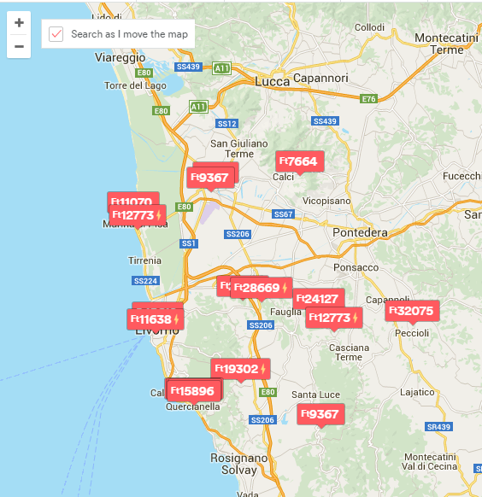
GEOSPATIAL SEARCH
COORDINATES TO EACH RECORD
QUERY:
AREA BY DIFFERENT SHAPES
PROXIMITY

Slide 89
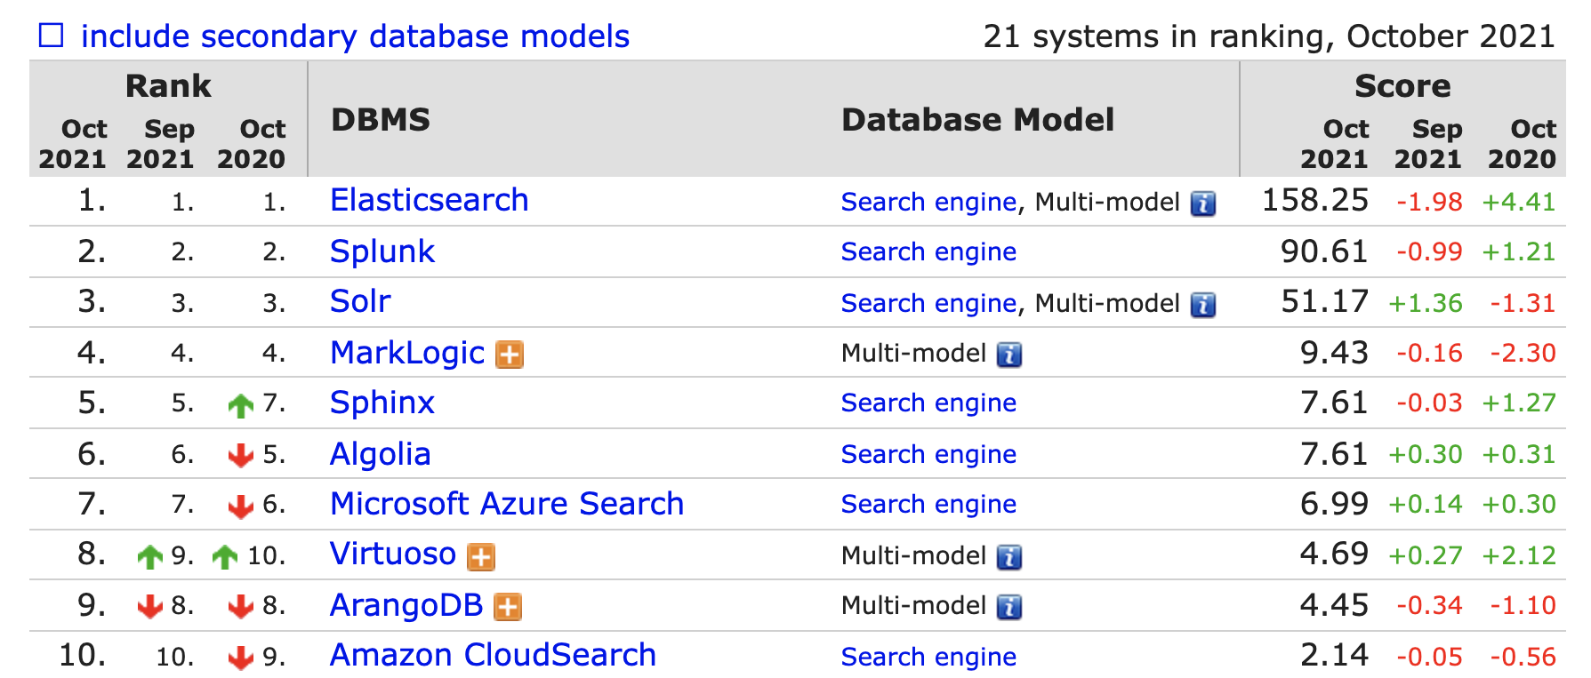
SEARCH ENGINES RANK

Slide 90

PRACTICE

Slide 91
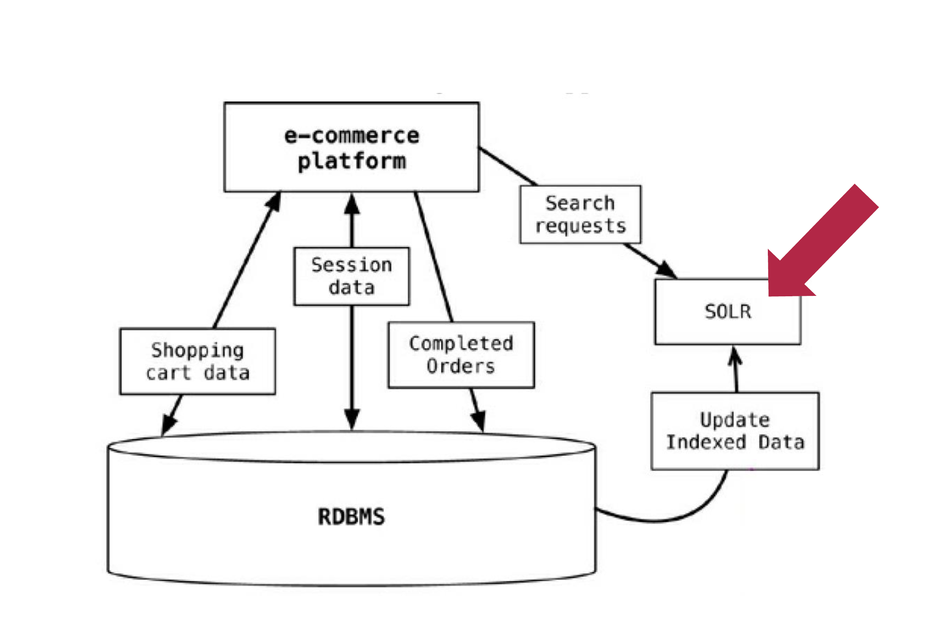
USECASE - ECOMMERCE

Slide 92
NOSQL CLASSIFICATION
KEY-VALUE STORES
TIME SERIES DBMS
DOCUMENT STORES
COLUMN STORES
SEARCH ENGINES
GRAPH DBMS

Slide 93
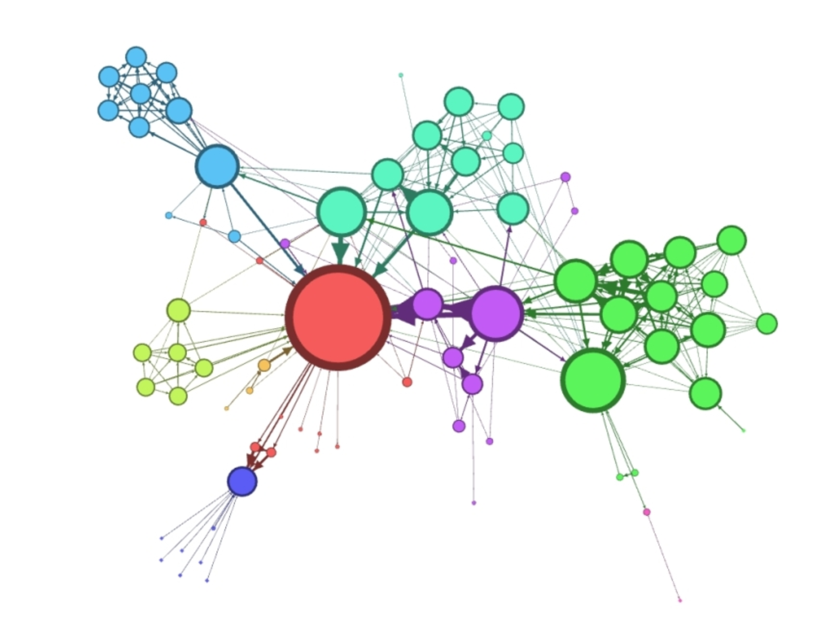
GRAPH DATA STRUCTURES

Slide 94

NETWORK SCIENCE
HOW KEVIN BACON CHANGED DATA SCIENCE ?

Slide 95


BOOKS

Slide 96
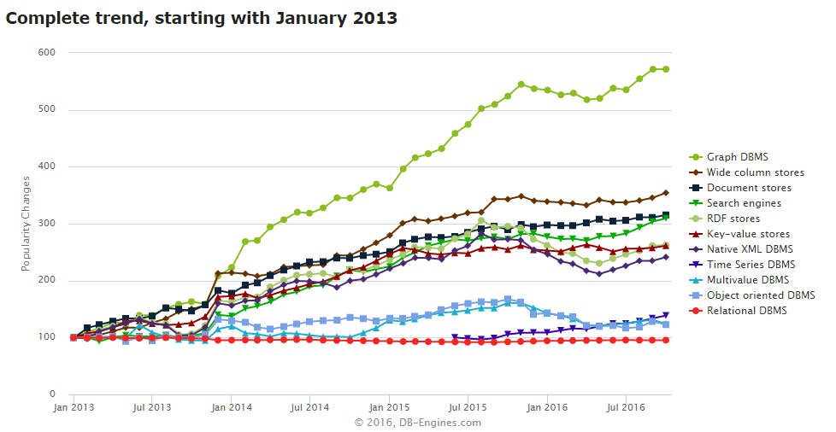
DATA SCIENCE
NEW
TYPE
ANALYTICS

Slide 97
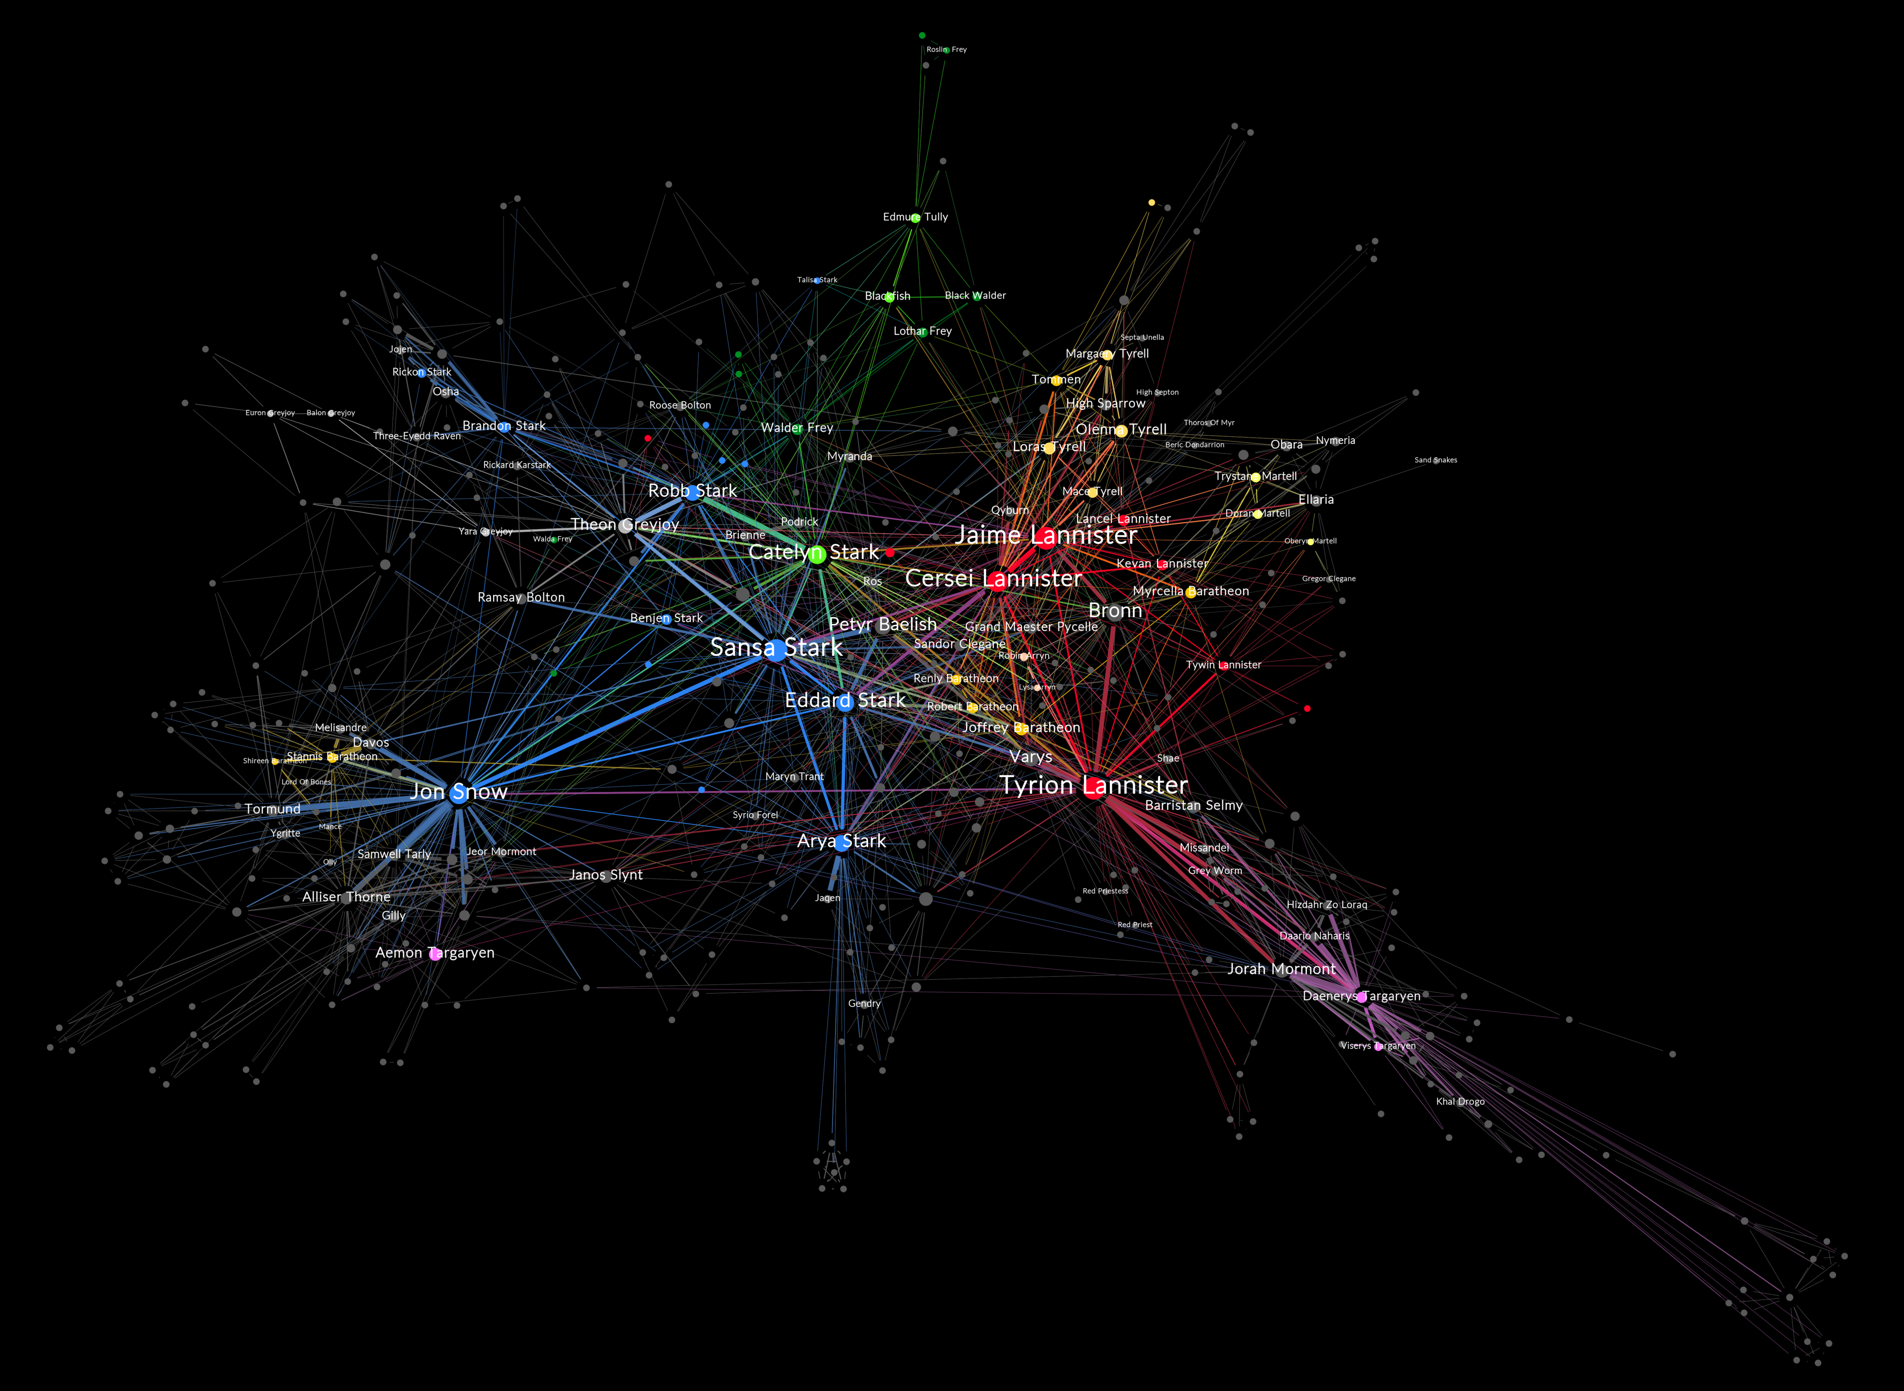
FEATURE ENGINEERING

Slide 98


ROBUSTNESS TESTING
Notes:
INSTEAD OF EXPLORING EMPIRICALLY

Slide 99
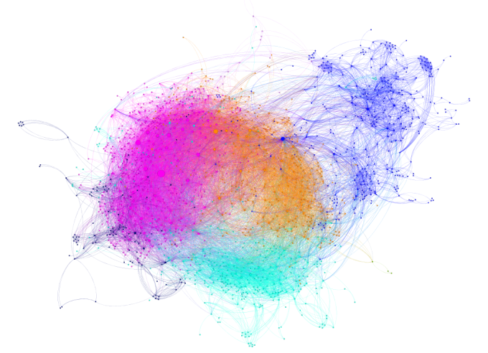
SEGMENTATION / FRAUD DETECTION

Slide 100
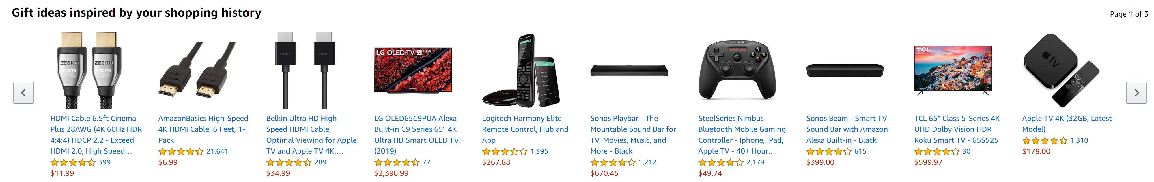
RECOMMENDATION ENGINE

Slide 101
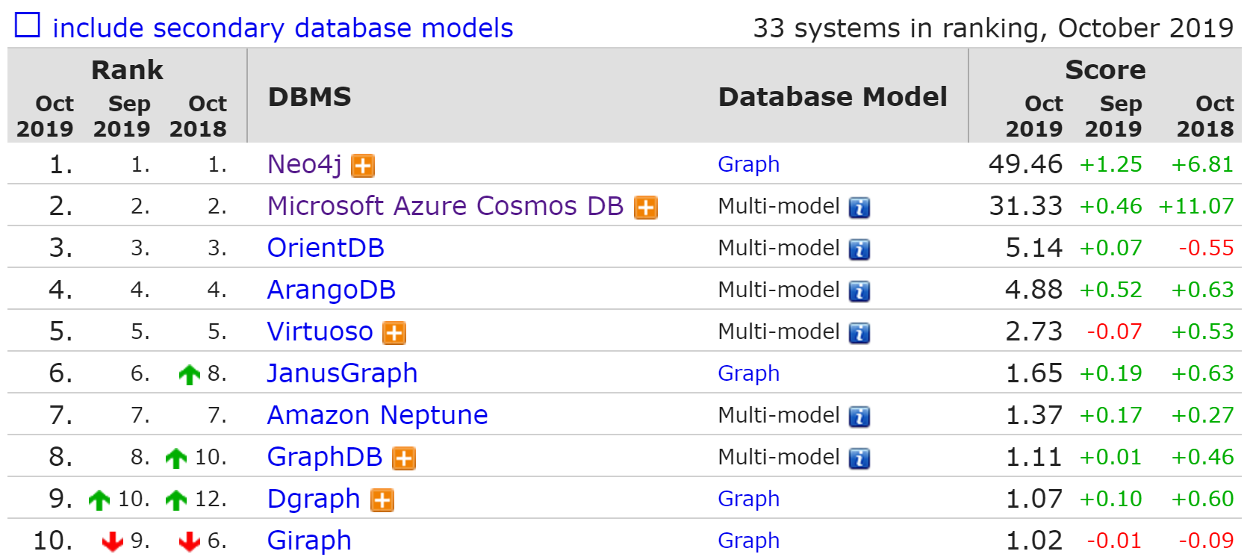
GRAPH DBMS RANK

Slide 102

PRACTICE

Slide 103
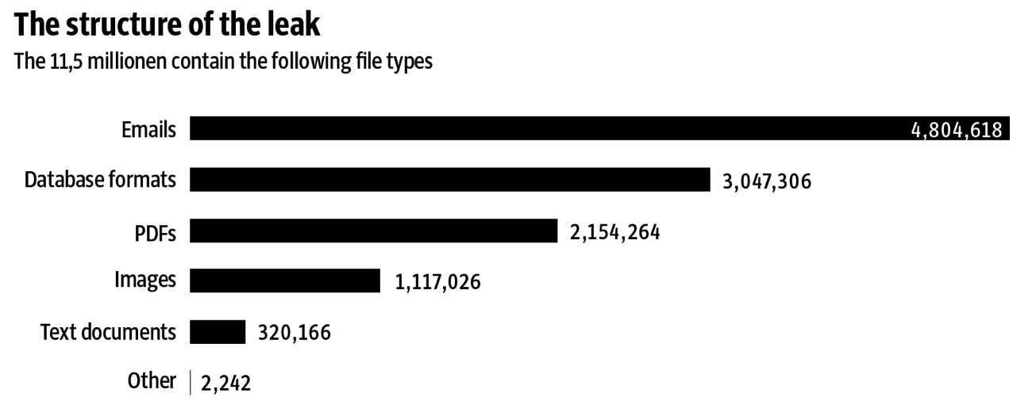
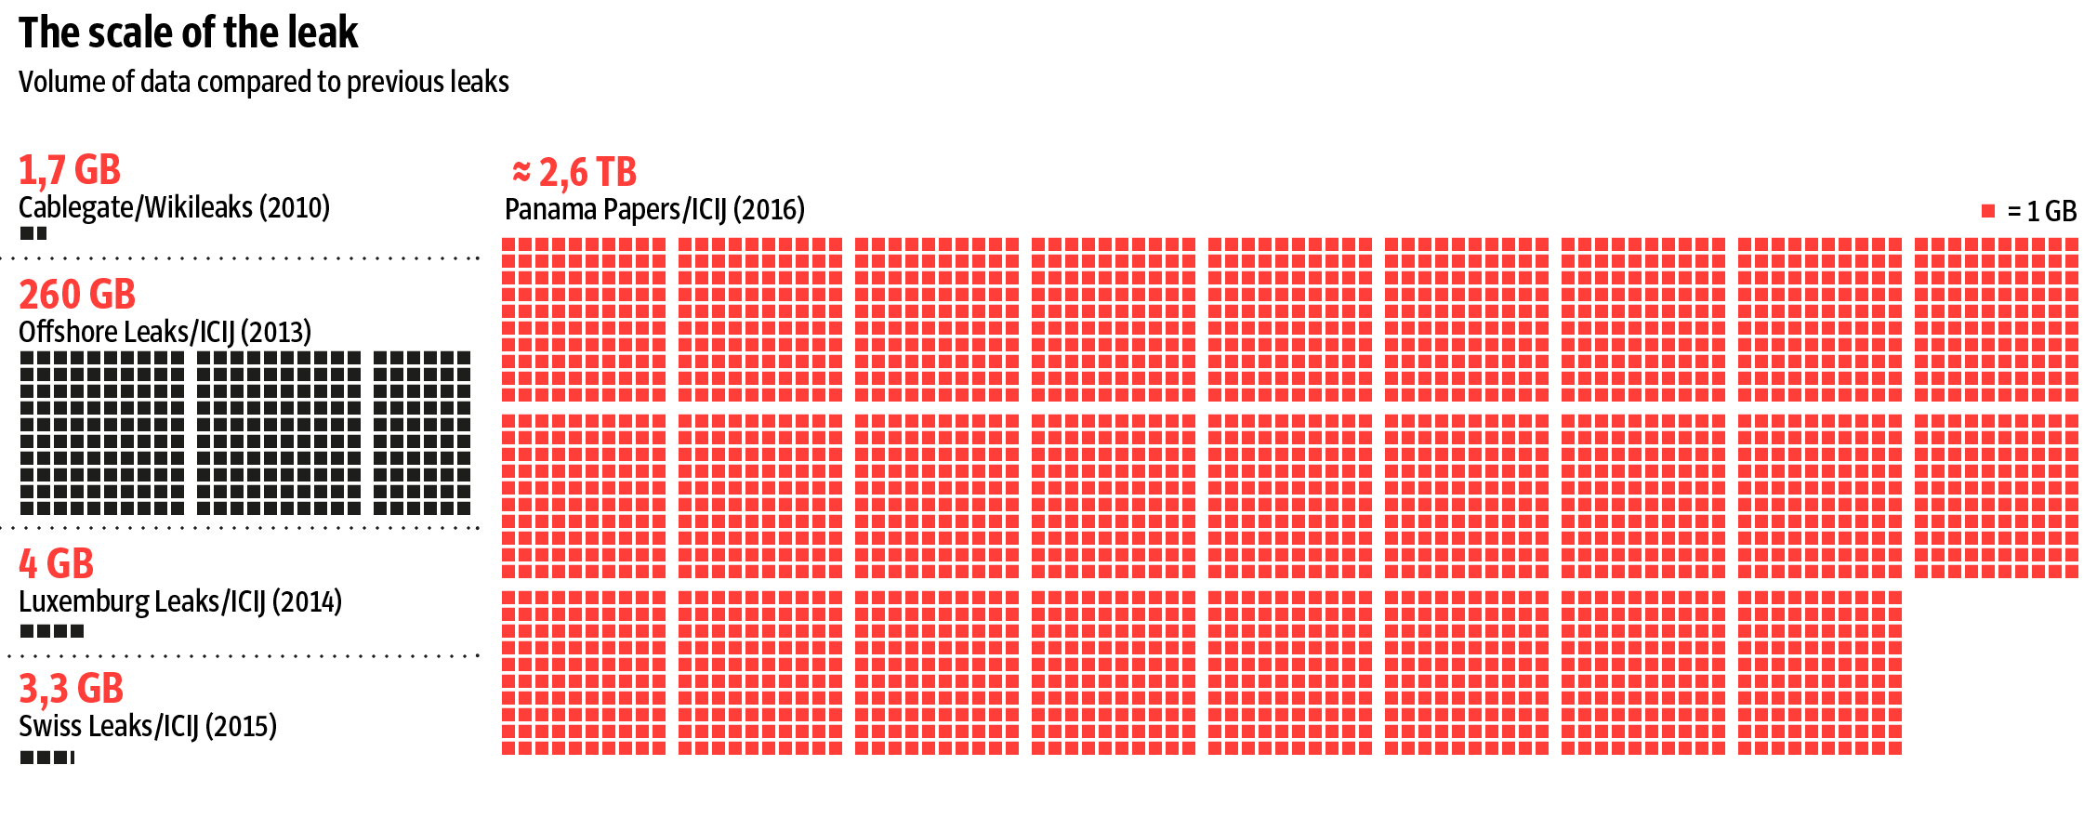
PANAMA PAPERS

Slide 104
PANAMA PAPERS – CLASSICAL FLOW
SCAN
OCR
DIGITAL TEXT
ETL
STRUCTURED DATA
RDBMS
SQL API
ANALYTICS
SOME STRUCTURED DATA
DATA MINING

Slide 105
WITH SEARCH ENGINE
Rich Document Parsing or NLP
Text Analysis
SCAN
SOLR +TIKA
DATA INGESTION
DATA INGESTION
DATA INGESTION
ANALYTICS
SEARCH ALGORITHM
SEARCH ALGORITHM
SEARCH ALGORITHM

Slide 106
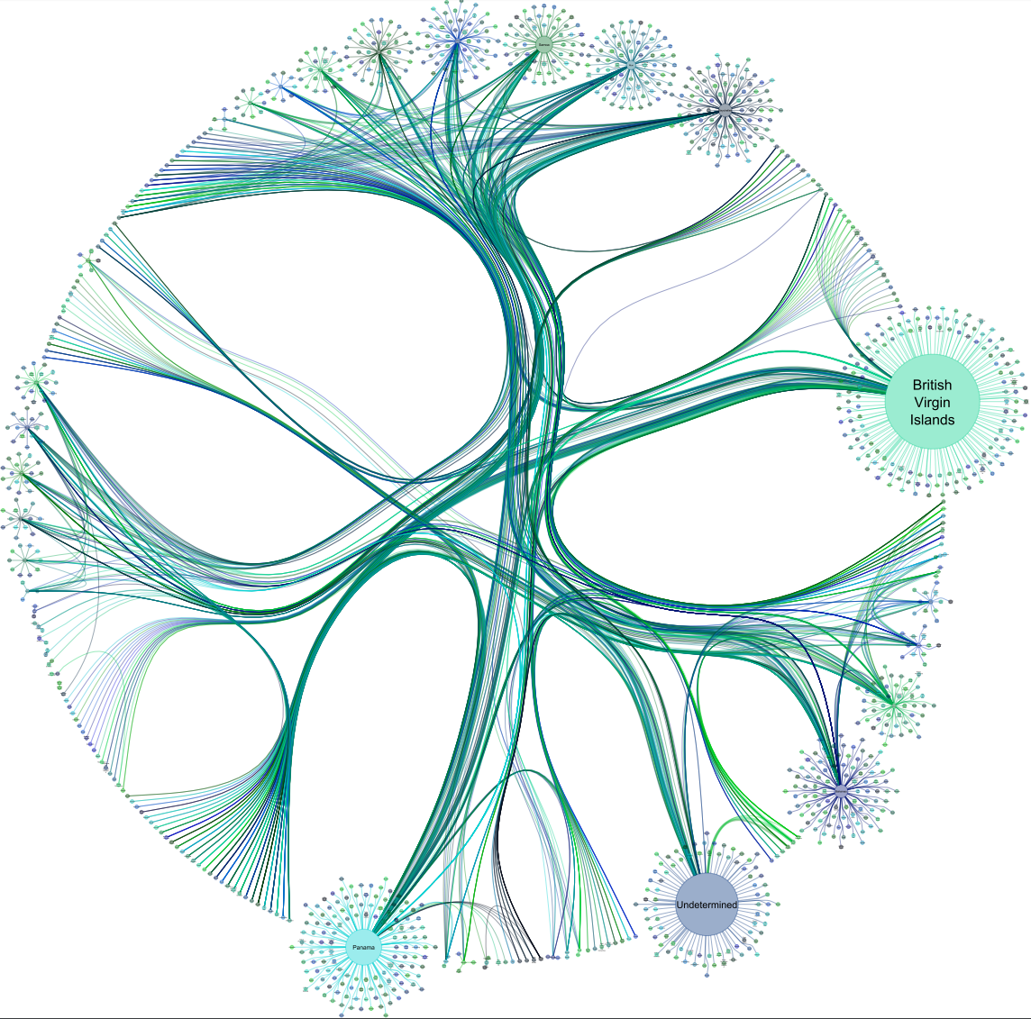

ADVANCED ANALYTICS
NEO4J
SOLR +TIKA
DATA INGESTION
DATA INGESTION
DATA INGESTION
ML
MODEL
SEARCH ALGORITHM
SEARCH ALGORITHM
SEARCH ALGORITHM

Slide 107
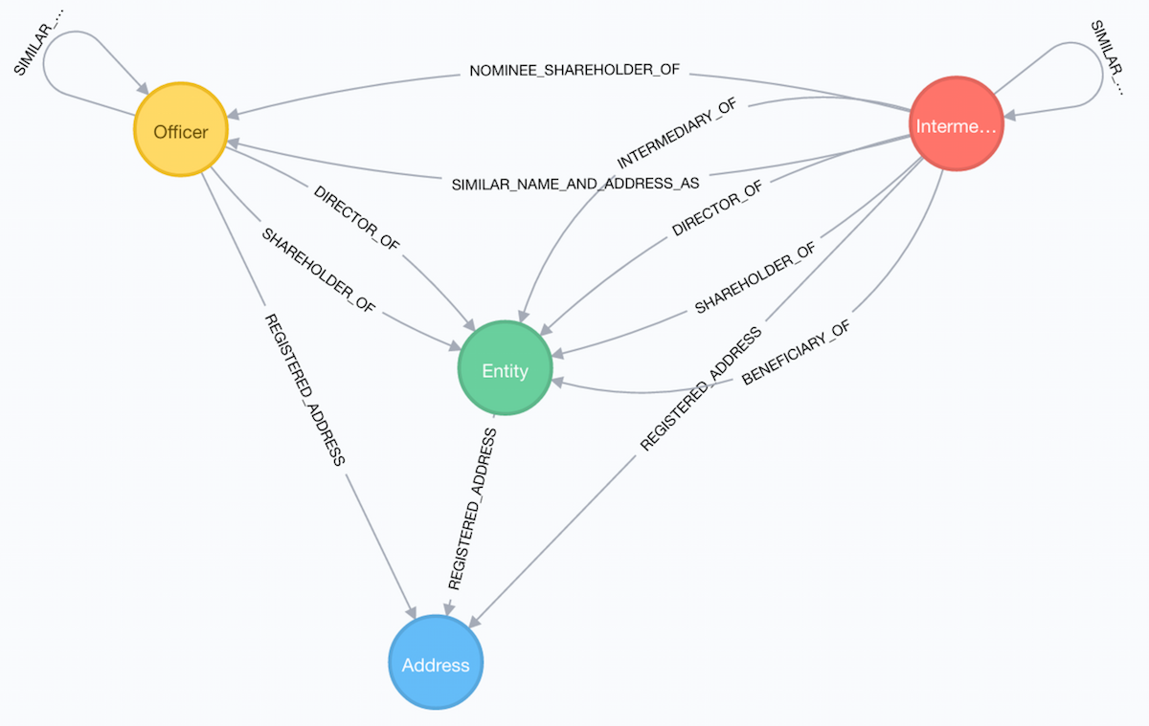
PANAMA PAPERS SCHEMA
Entity - The offshore legal entity. This could be a company, trust, foundation …
Officer - A person or company who plays a role in an offshore entity, such as beneficiary, director, or shareholder.
Intermediary - A go-between for someone seeking an offshore corporation and an offshore service provider — usually a law-firm or a middleman that asks an offshore service provider to create an offshore firm.
Address - The registered address

